Slide 1
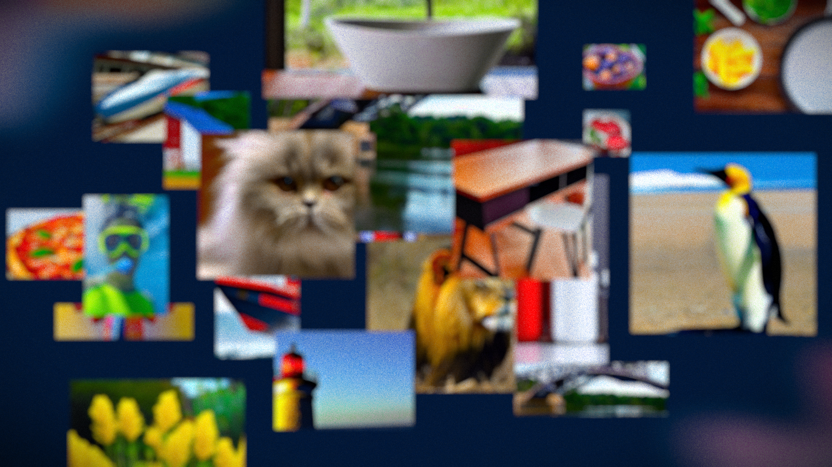
Leveraging Diffusion Models for Data Scarcity
Evaluating Classification Performance with Synthetic Images
Pola Gnana Shekar
21CS10052

Slide 2







Introduction
Early datasets were small, but demand for more accurate models drove the need for massive datasets.
Creating large datasets is labor-intensive and costly, limiting their availability.
Generative AI models like DALL-E and Stable Diffusion offer solutions to data scarcity and high curation costs.
Synthetic data generation enables vast, diverse datasets, expanding opportunities for computer vision tasks.

Slide 3

Problem Statement
As growing need for high-quality datasets in computer vision poses a significant challenge, especially when real-world data is hard to find or limited.
Explore with diffusion models, particularly stable diffusion, to generate synthetic images to address data scarcity in computer vision.
Train classification models on both real and synthetic datasets, evaluate whether synthetic data can effectively substitute real images, providing insights into the potential of generative AI for data-limited tasks.

Slide 4
Related Work
Advancements in Generative Models:
[Saharia at el., 2022(3)].: Photorealistic text-to-image diffusion models with deep language understanding [Ruiz at el., 2022(4)].: Fine-tuning text-to-image diffusion models for subject-driven generation
Better Prompting for better Quality:
[Hao et al., 2022(1)]: Optimizing prompts for text-to- image generation
[Sariyildiz et al., 2022 (2)]: Learning transferable representations from synthetic ImageNet clones
Learning from Synthetic Data:
[Ros at el., 2016 (5)]: A large collection of synthetic images for semantic segmentation of urban scenes [Rozontsev et al., 2015(6)] :On rendering synthetic images for training an object detector
Potential of Synthetic Images:
[Sariyildiz et al., 2022(2)].: Fake it till you make it: Learning transferable representations from synthetic
ImageNet clones.

Slide 5
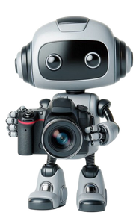
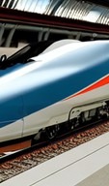

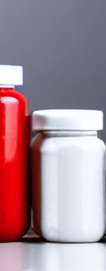
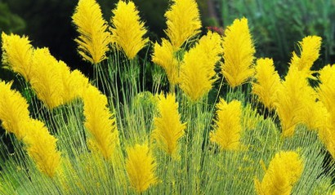
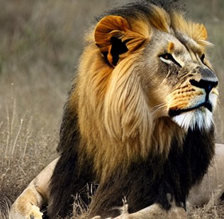
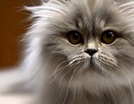
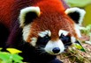
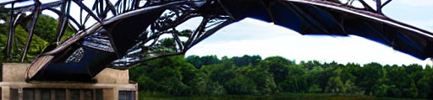
Tiny ImagNet
Tiny ImageNet is a compact version of the original ImageNet dataset, It serves as a benchmark for developing and evaluating machine learning models
Features:
Image Resolution: 64 x 64 Stored in RGB Format 200 Distinct Classes
Splits:
Training: 500 images/class = 1,00,000 images
Valid: 50 images/class = 10,000 images
Test: 50 images/class = 10,000 images

Slide 6
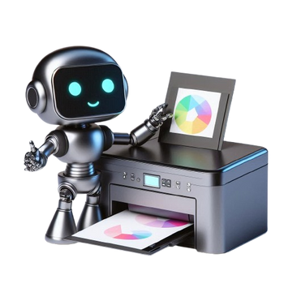
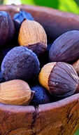
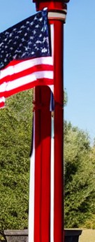

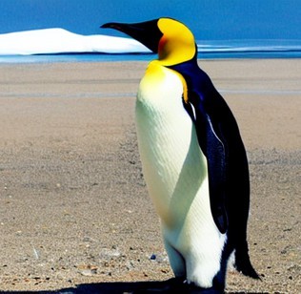
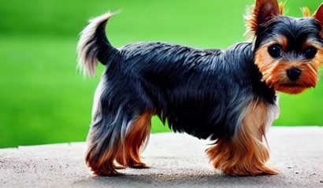
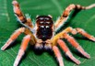
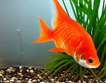
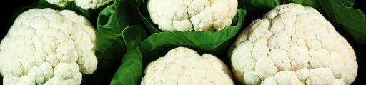
Synthetic Dataset
This dataset is generated using the stable diffusion model. Consists of 200 distinct classes with each class having 500 images
Features:
Generated Resolution: 512 x 384
Resized resolution: 64 x 64
200 Distinct Classes
500 images/class = 1,00,000 synthetic images
Tiny ImageNet classes are taken as reference for dataset generation

Slide 7



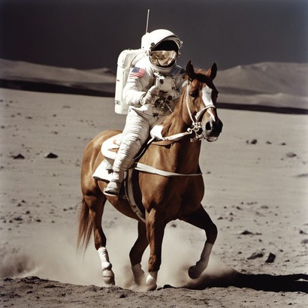
Stable Diffusion
Generate an Image of astronaut on the moon riding a horse
Stable Diffusion is a text-to-image diffusion model renowned for its efficient, high-quality image generation.
Parameters:
Guidance Scale: Adjusts adherence to prompts Sampling Steps: setting the number of denoising steps. Resolution: specifies resolution.
Stable Diffusion
Features:
Prompt Based Generation: Image generation controlled by Text prompts
Efficiency: Generates images quickly with lower resources. Can generate complex scenes from a single prompt.

Slide 8

Prompting
Class Name
Tiny ImageNet
Classes
WordNet
Class defination
Class Hypernym
goldfish, Carassius auratus, cyprinid, cyprinid_fish, small golden or orange-red freshwater fishes of Eurasia used as pond or aquarium fishes

Slide 9
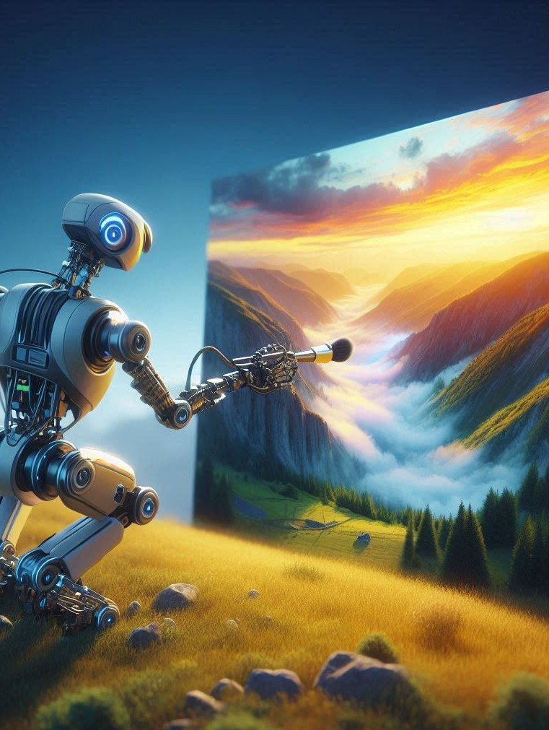
Image Generation
For each class, a specific prompt is crafted, followed by generating 500 images per class
Each generated image is set to a resolution of 512x384 pixels with a guidance scale of 7.5 to maintain quality and relevance to the prompt.
Using a Tesla K80 GPU (CUDA 11.4), each image takes an average of 60-75 seconds to generate image
The Image generation is carried on multiple GPUs to speed up the generation process.

Slide 10
Classification Model
Input Image
Base Model: ResNet50 with an input shape of 224x224x3, using pretrained weights from ImageNet and Last 5 layers unfrozen for fine-tuning.
ResNet50 Encoder
Hidden Layer: Using a hidden layer with 512 nodes and ReLU activation for non - linearity.
Dense layer (512 node)
Output Layer: SoftMax layer with 200 nodes for multi- class classification
Softmax (200 node)
Class
Optimizer: SGD optimizer with an initial learning rate of 0.0001 and momentum of 0.9.

Slide 11





Training and Testing
Before training, images are preprocessed using DINO transformations to align with model input requirements.
Model trained over 25 epochs with a batch size of 512, each epoch taking 40-45 minutes on a Tesla P100 GPU.
Tiny ImageNet - test set is used for testing the model which contains 200 classes with 50 images per class
On this test set the accuracy of the trained model is calculated as evaluation metric.

Slide 12
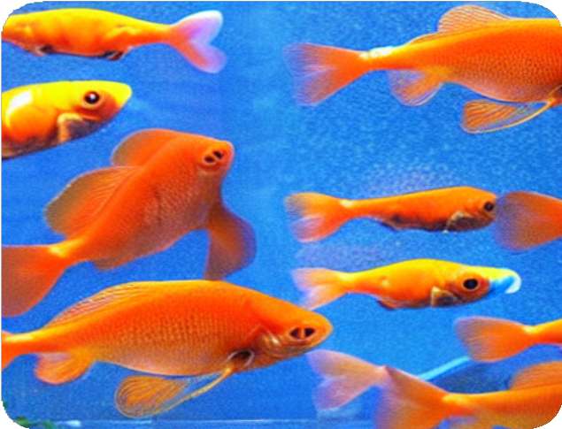
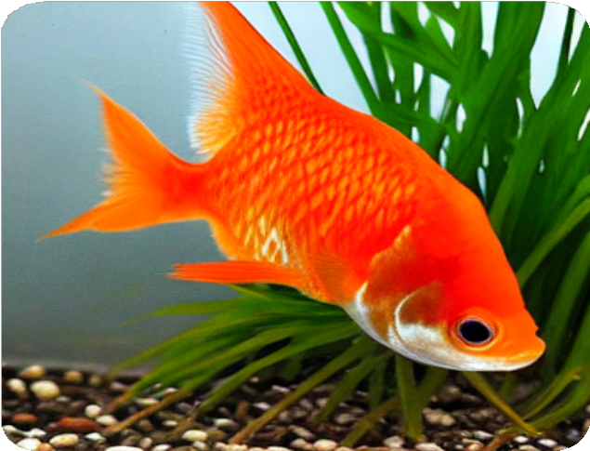
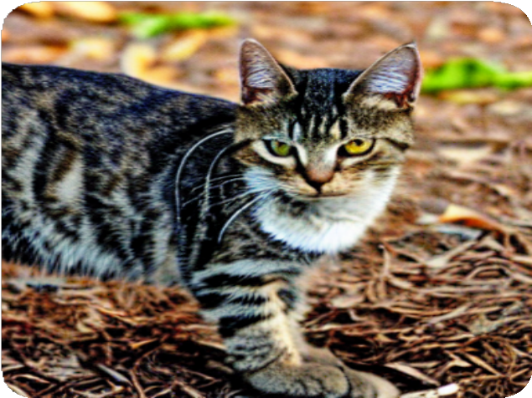
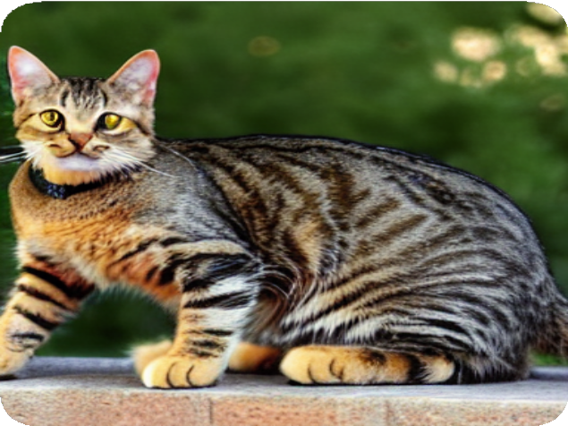
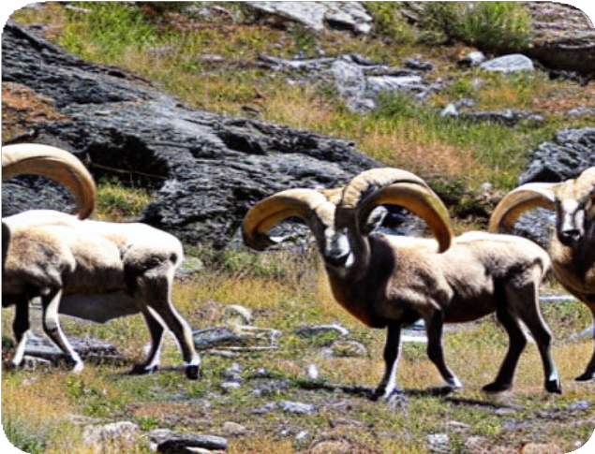
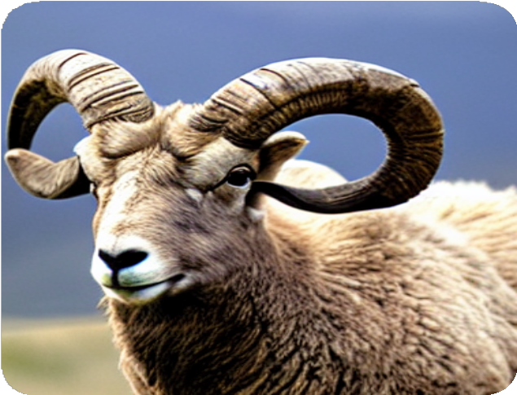
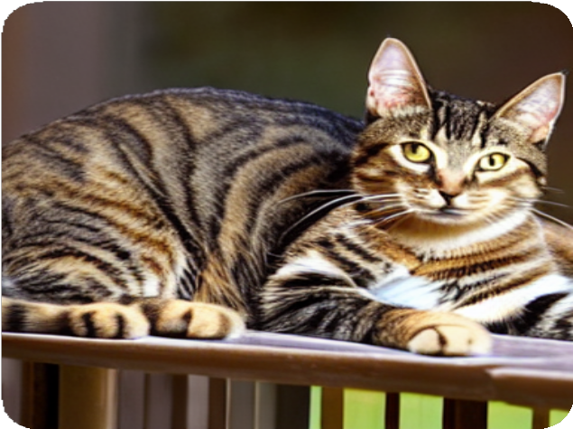
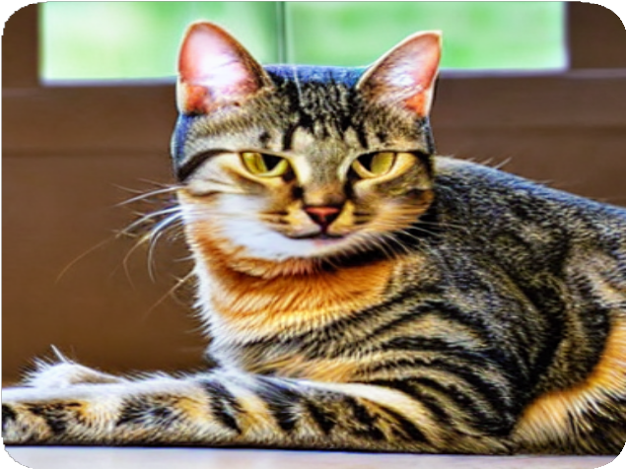
Results
Different number of Objects
Various Backgrounds

Slide 13
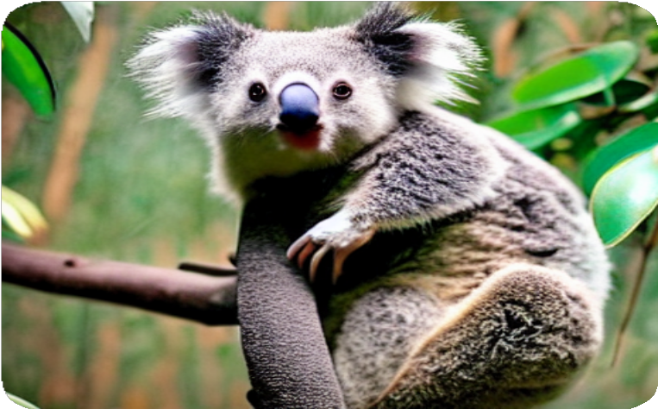
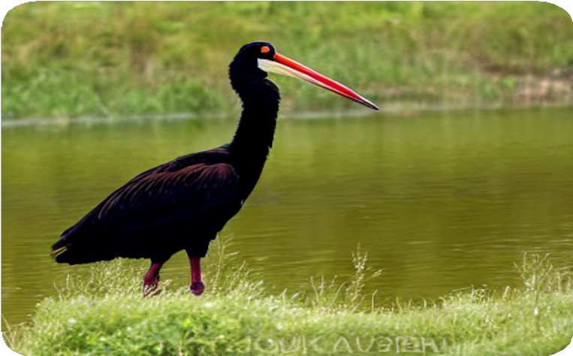
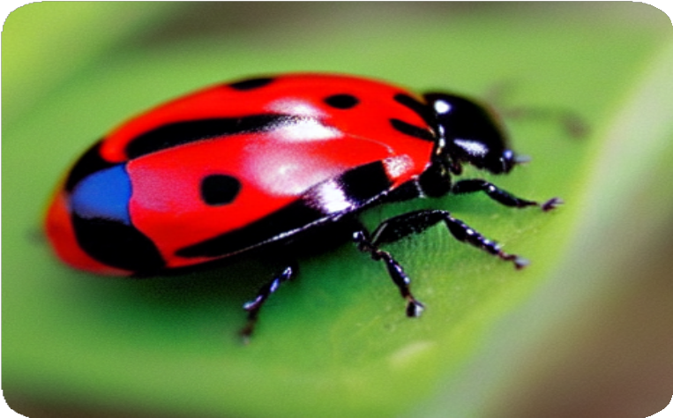
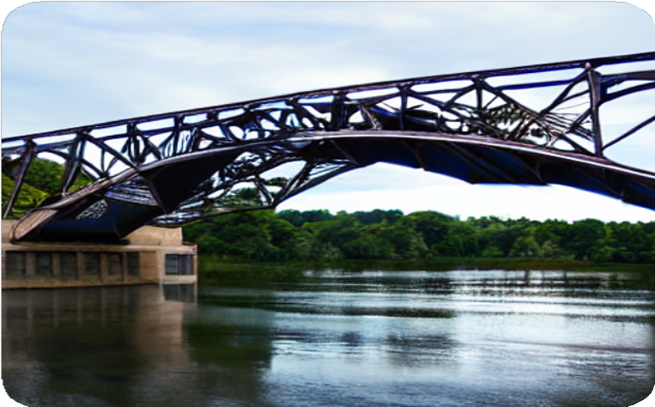
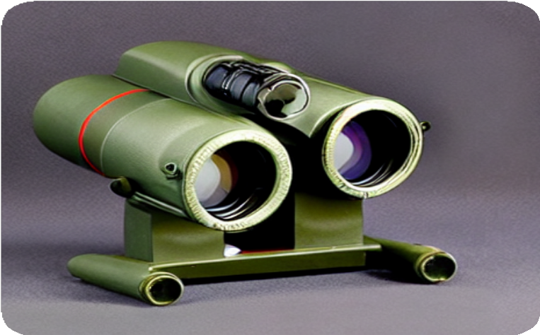
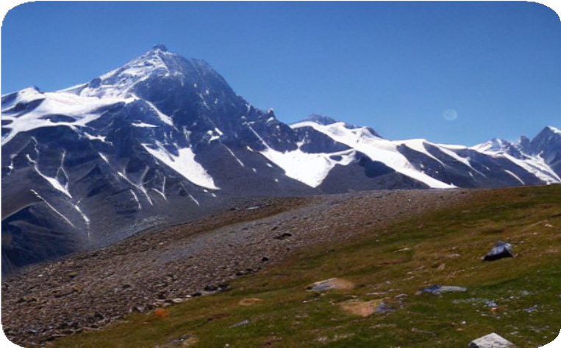
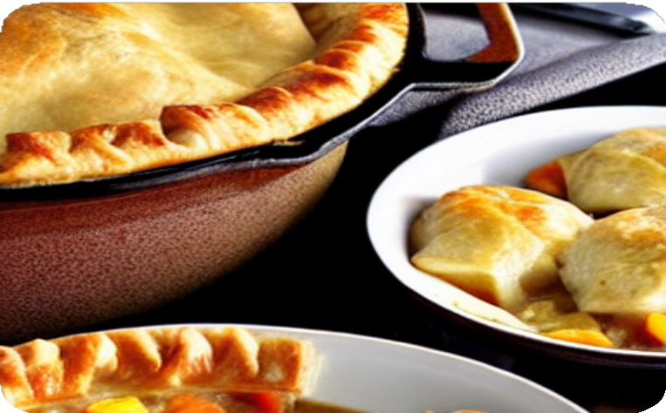
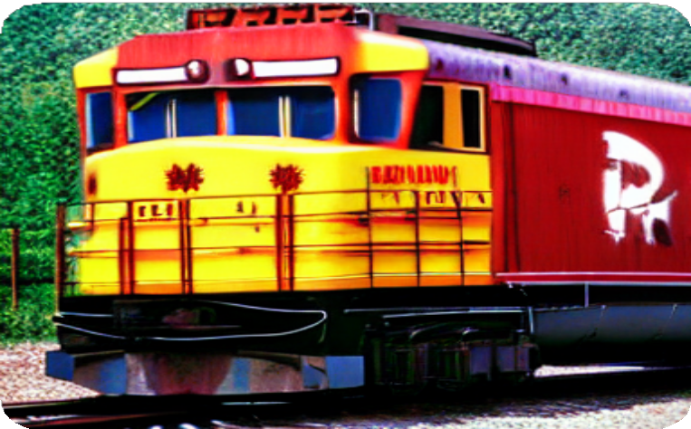
Results
Images Across various Domains

Slide 14
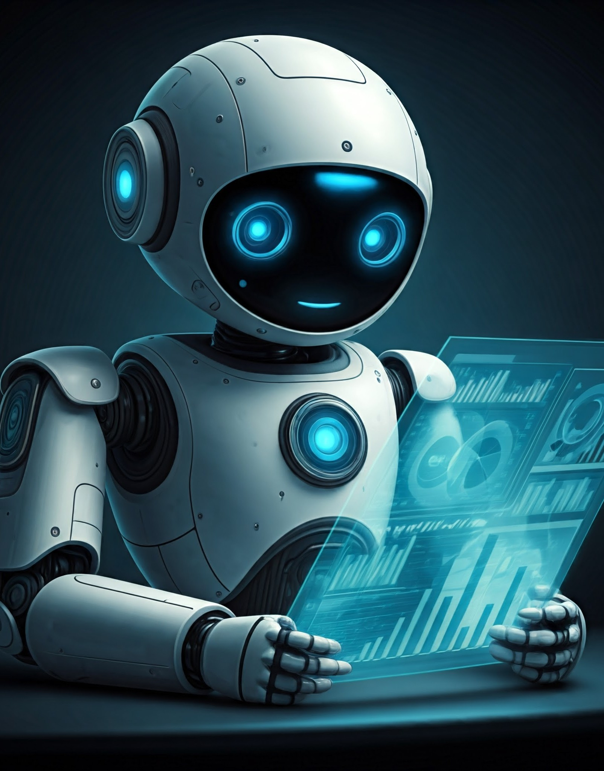

Results
Accuracy of Model trained on Tiny ImageNet:
24.11 %.
Accuracy of Model trained on Synthetic Dataset:
23.86 %.
Despite the low accuracy scores of models trained on real (24.11) and synthetic images (23.86), the closeness of these scores suggests that the synthetic images are well-generated, performing comparably to real images. Further refinement of training could improve results.

Slide 15

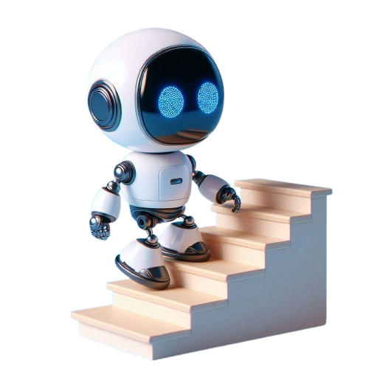

Future Steps
the model accuracy can be improved by adding more layers or nodes into the model architecture.
Better results can be obtained by focusing on specific domains
- domain adaption
Enhanced prompting and adjustments in parameters (e.g., guidance scale, sampling steps) can further refine generated images.
testing on various tasks can help use to understand and use the synthetic datasets.

Slide 16

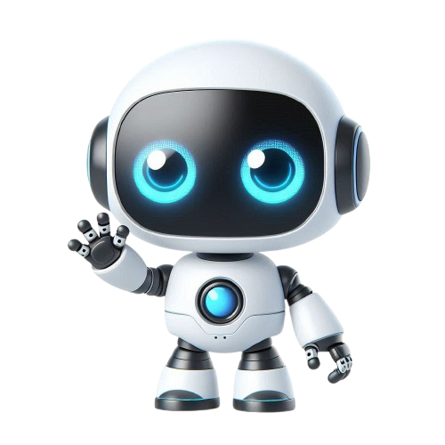
Thank You

